Slide 1
Inland Plumbing, Gasfitting and Drainlaying Ltd.
“Your one stop shop for all Plumbing, Gasfitting and Drainage needs”

Slide 2
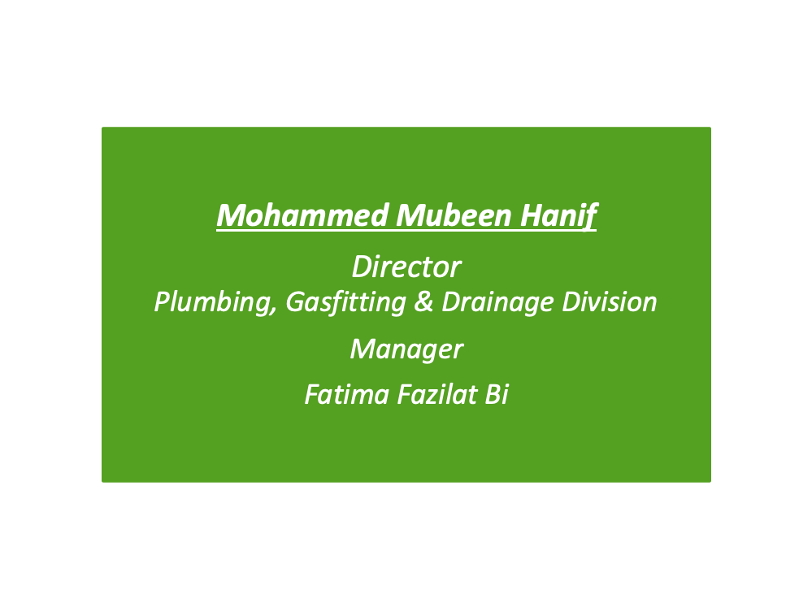
Company Management Team

Slide 3
VISION STATEMENT
Inland Plumbing, Gasfitting and Drainlaying Ltd will constantly strive to become the one and only “One Stop Shop” for all clients across the Greater Auckland region.

Slide 4
Certifiers
Mohammed Mubeen Hanif (Director)
  Certified Gas-Fitter/ Plumber / Drainlayer – Director
Abdul Akeem
  Certified Plumber

Slide 5
Apprentice and Registered Staff
Mohammed Imran Khan
  exemption Gas-Fitter / Plumber
Maruariki Tuaputa
  Apprentice Drainlayer
Tangi Tuaputa
  Exemption Drainlayer (17years experience)
Abdul-Khaliq Abdul-Aziz
  Registered Plumber & Gas-fitter (6years experience)
  Tasleem Niyaz Khan
  Exemption plumber(3.5 years experience)
  Abdul Ashaad Khan
  Exemption Plumber(5 years experience)
  Divnesh nandan
  Exemption plumber (7 years experience)

Slide 6
Company Profile
Inland Plumbing, Gasfitting and Drainlaying Ltd has a fully integrated office management system, providing a direct ‘real time’ link to all our service technicians, whether working or on stand by, at all times. With full drainage solutions
This allows Inland Plumbing, Gasfitting & Drainlaying Ltd to provide a guaranteed 4 hour response to all calls
This can be further developed to incorporate a
1 hour Gas Emergency Response

Slide 7
Company Mission
We are committed to providing our Customers with a service that satisfies their needs and expectations
Guarantee to meet the agreed quality standards set by our customers whilst regularly reviewing our Quality Management system to ensure continuous improvement
Quality is driven by all within Inland Plumbing, Gasfitting & Drainlaying Ltd and we continuously strive to give our Customers the very best service whilst delivering against all documented KPI’s

Slide 8
Health & Safety Policy
Inland Plumbing, Gasfitting and Drainlaying Ltd is committed to ensuring the health, safety and well being of all of its employees and other people affected by its operation.
We strive towards eliminating harm to all employees and others
Inland Plumbing, Gasfitting & Drainlaying Ltd is committed to fostering a culture of positive Oh&S practises and achieve zero incidents
This is achieved through ongoing employee training, communication and company wide participation

Slide 9
Quality System Management
Evaluation and inspection of contracts to ensure compliance standards are achieved
Ensure deficiencies in the quality of contract work is highlighted and the necessary corrective action taken
Ensure non compliance and defective work is remedied and repetition is eliminated
Ensure full compliance with specified quality standards
Formally report on non compliance to achieve continuous improvement

Slide 10
Communication & Reporting
Successful management of the contract undertaken will require a high level of communication and trust between both parties
Inland Plumbing, Gasfitting and Drainlaying Ltd will be dedicated to providing prompt and clear communication in a timely manner to all parties

Slide 11
Training
All new employees are involved in a standard induction process based around all of our company policies and procedures
Annual meetings are held with Product Managers with regards to ongoing training
Inland Plumbing, Gasfitting and Drainlaying Ltd are actively involved with Unitec and MIT to ensure our staff receive the latest training available for the Industry

Slide 12
Monitoring & Controlling
Inland Plumbing, Gasfitting and Drainlaying Ltd continuously monitor and control all of their contracts to ensure they are achieving the stipulated quality standards and KPI’s
We will maintain records of all work done and archive on regular periodic intervals

Slide 13
Dedicated Service
24 Hour Emergency Service
  365 days of the year
Dedicated Phone system including:
  Answer machine
  Back up emergency phone number
  Secondary back up phone number
This has been tried and tested over the last 10+ years as part of the HNZ contract, which the director was involved in.

Slide 14
Current and Previous Contracts staff have been involved with
Being the primary Housing New Zealand maintenance contractors for the last 10 Years
  Reported to Spenser Henshaws Ltd, Spotless, Programmed Services
Provided a dedicated 24 hour, 7 days a week, 52 weeks a year emergency call out service for the Housing New Zealand Maintenance Contract, for the last 10 years, across all aspects of Gas fitting, Plumbing and Drainlaying

